Slide 1



Site Suitability Assessment for Renewable Energy Resources
GGE 3423 Introduction to GIS
Fall Project
Dec 03, 2018

Slide 2
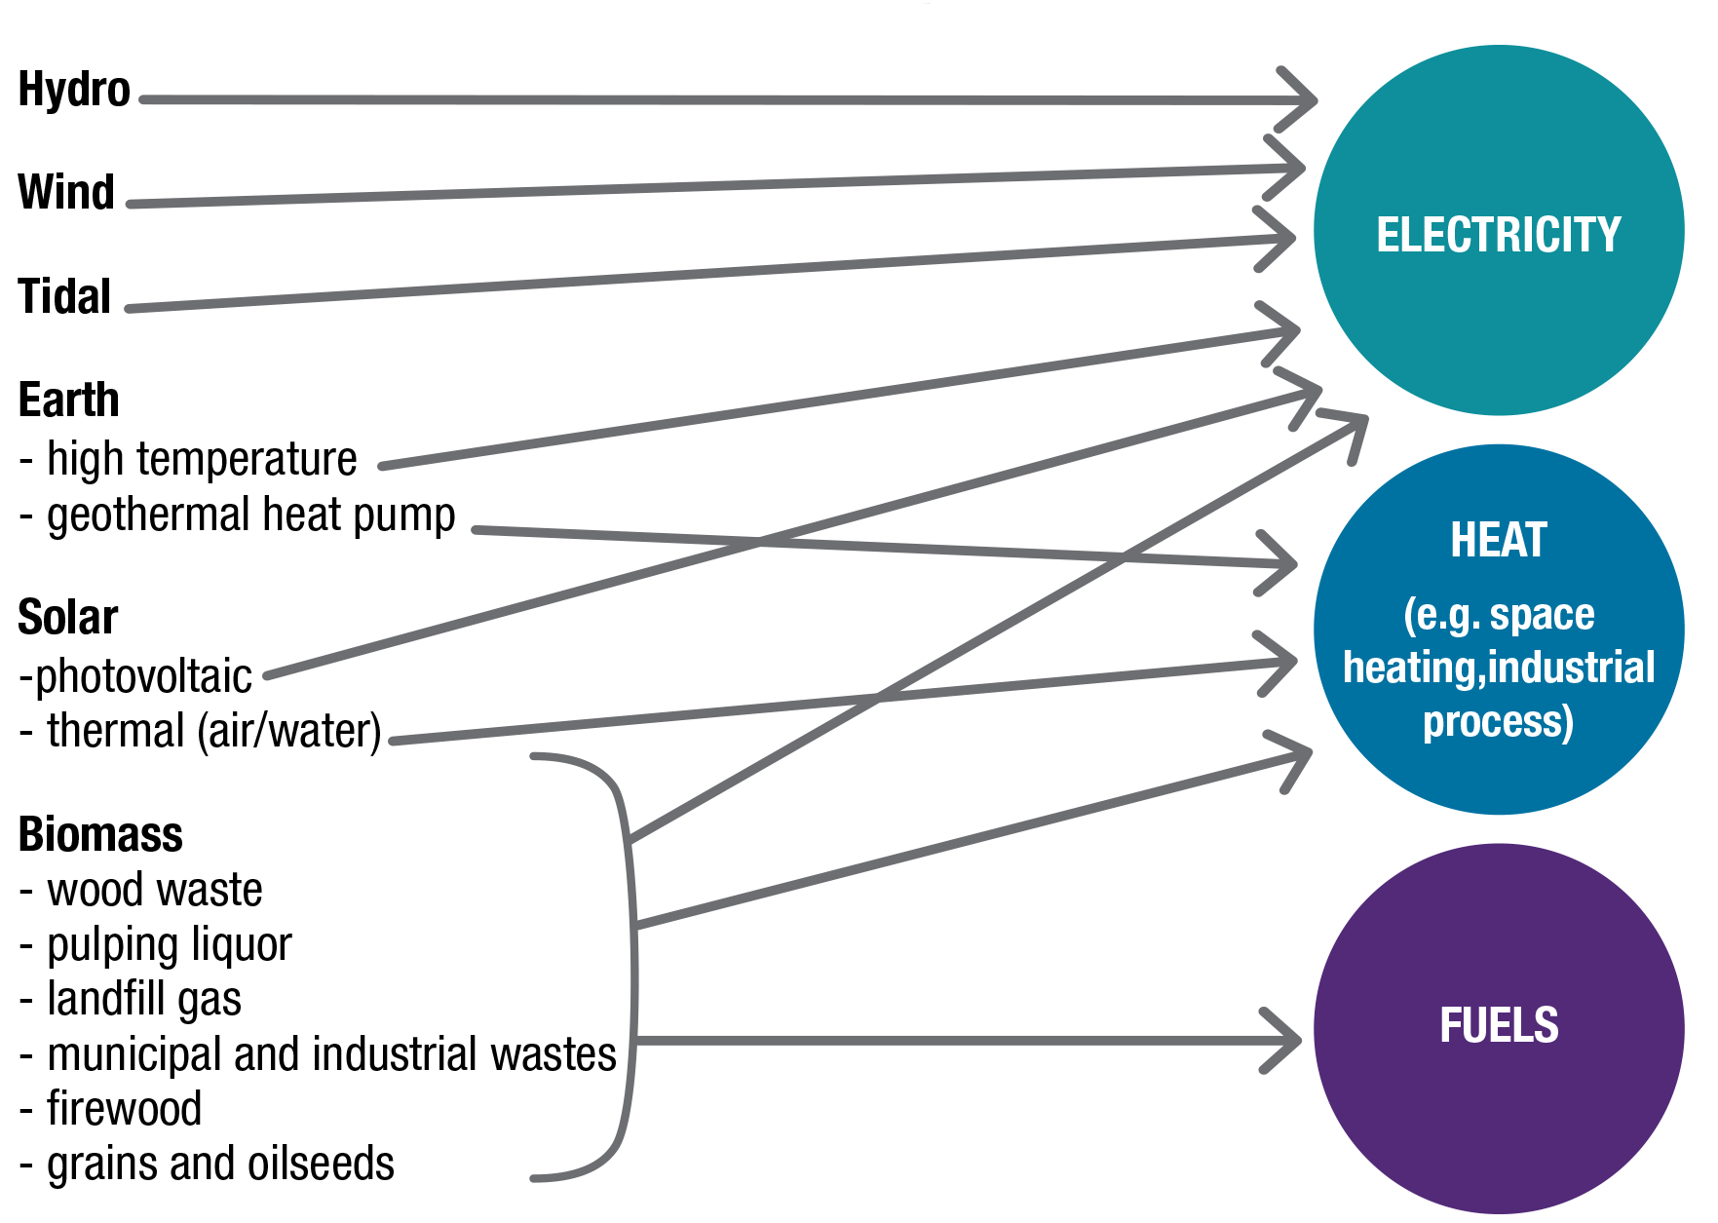
Natural Resources Canada
Renewable energy is derived from natural processes that are replenished at a rate that is equal or faster than the rate at which they are consumed.

Slide 3










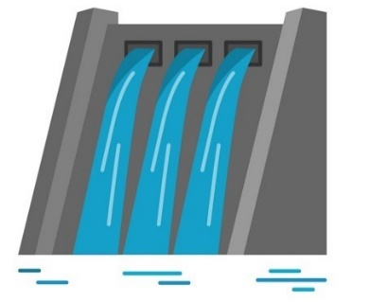



Slide 4
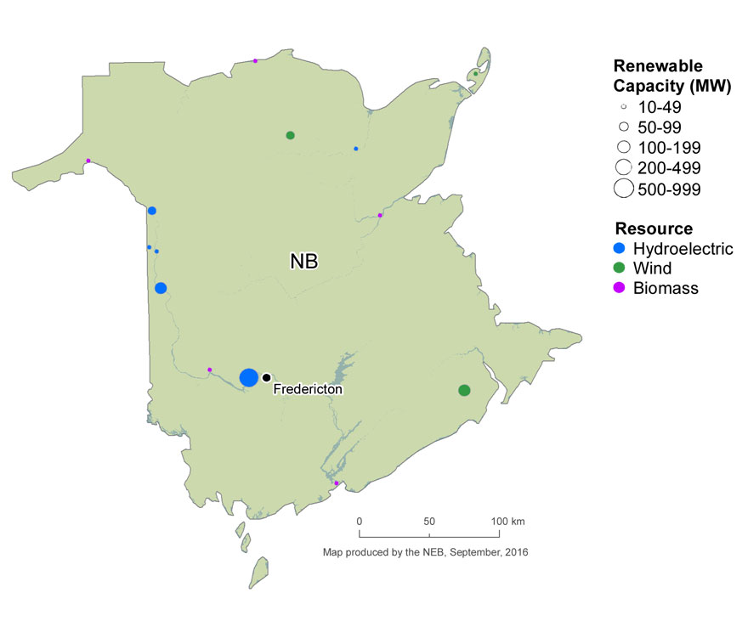
Source: https://www.neb-one.gc.ca/nrg/sttstc/lctrct/rprt/2016cndrnwblpwr/prvnc/nb-eng.html

Slide 5
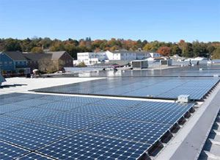
Solar - Photovoltaic Energy
In NB, Photovoltaic (PV) technology is becoming a preferred form of renewable energy technology due to social and economic factors, including:
To reduce greenhouse gas (GHG) emissions.
Deregulation and
Restructuring of electric power generating companies.
Photovoltaic (PV) systems are used to convert energy from the sun into electricity.
Safe and reliable source of solar electricity that produces no on-site pollution or emissions.
PV systems incur few operating costs
Installed on any kind of building, such as: Residential, Commercial, Industrial, Institutional, Agricultural etc.
https://www.pinterest.ca/pin/566398090606529059/
Objective
To assess the potential sites for solar photovoltaic energy generation

Slide 6
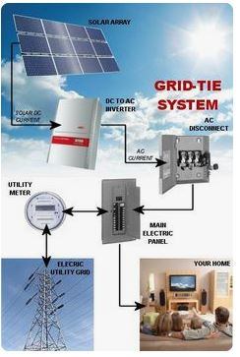
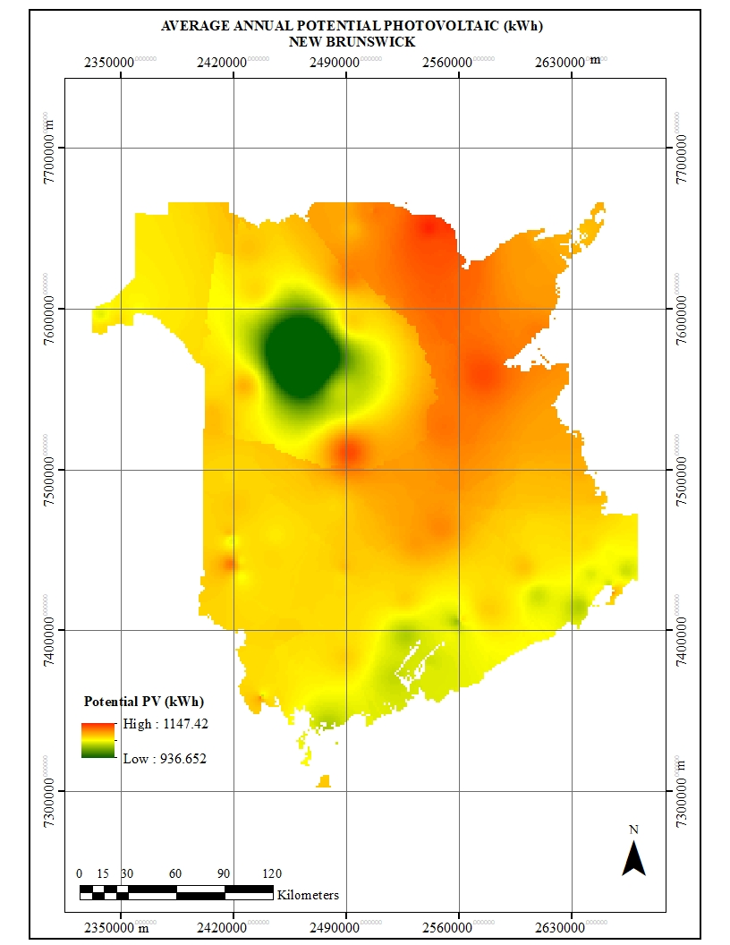
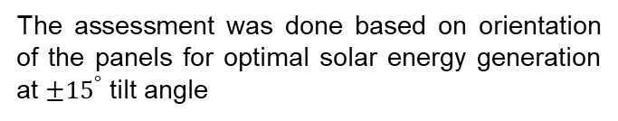
Solar - Photovoltaic Energy
Solar photovoltaic energy generation process
The assessment was done based on orientation of the panels for optimal solar energy generation at ${±15}^{°}$ tilt angle
https://www.pinterest.ca/
Potential sites for solar photovoltaic generation - NB

Slide 7
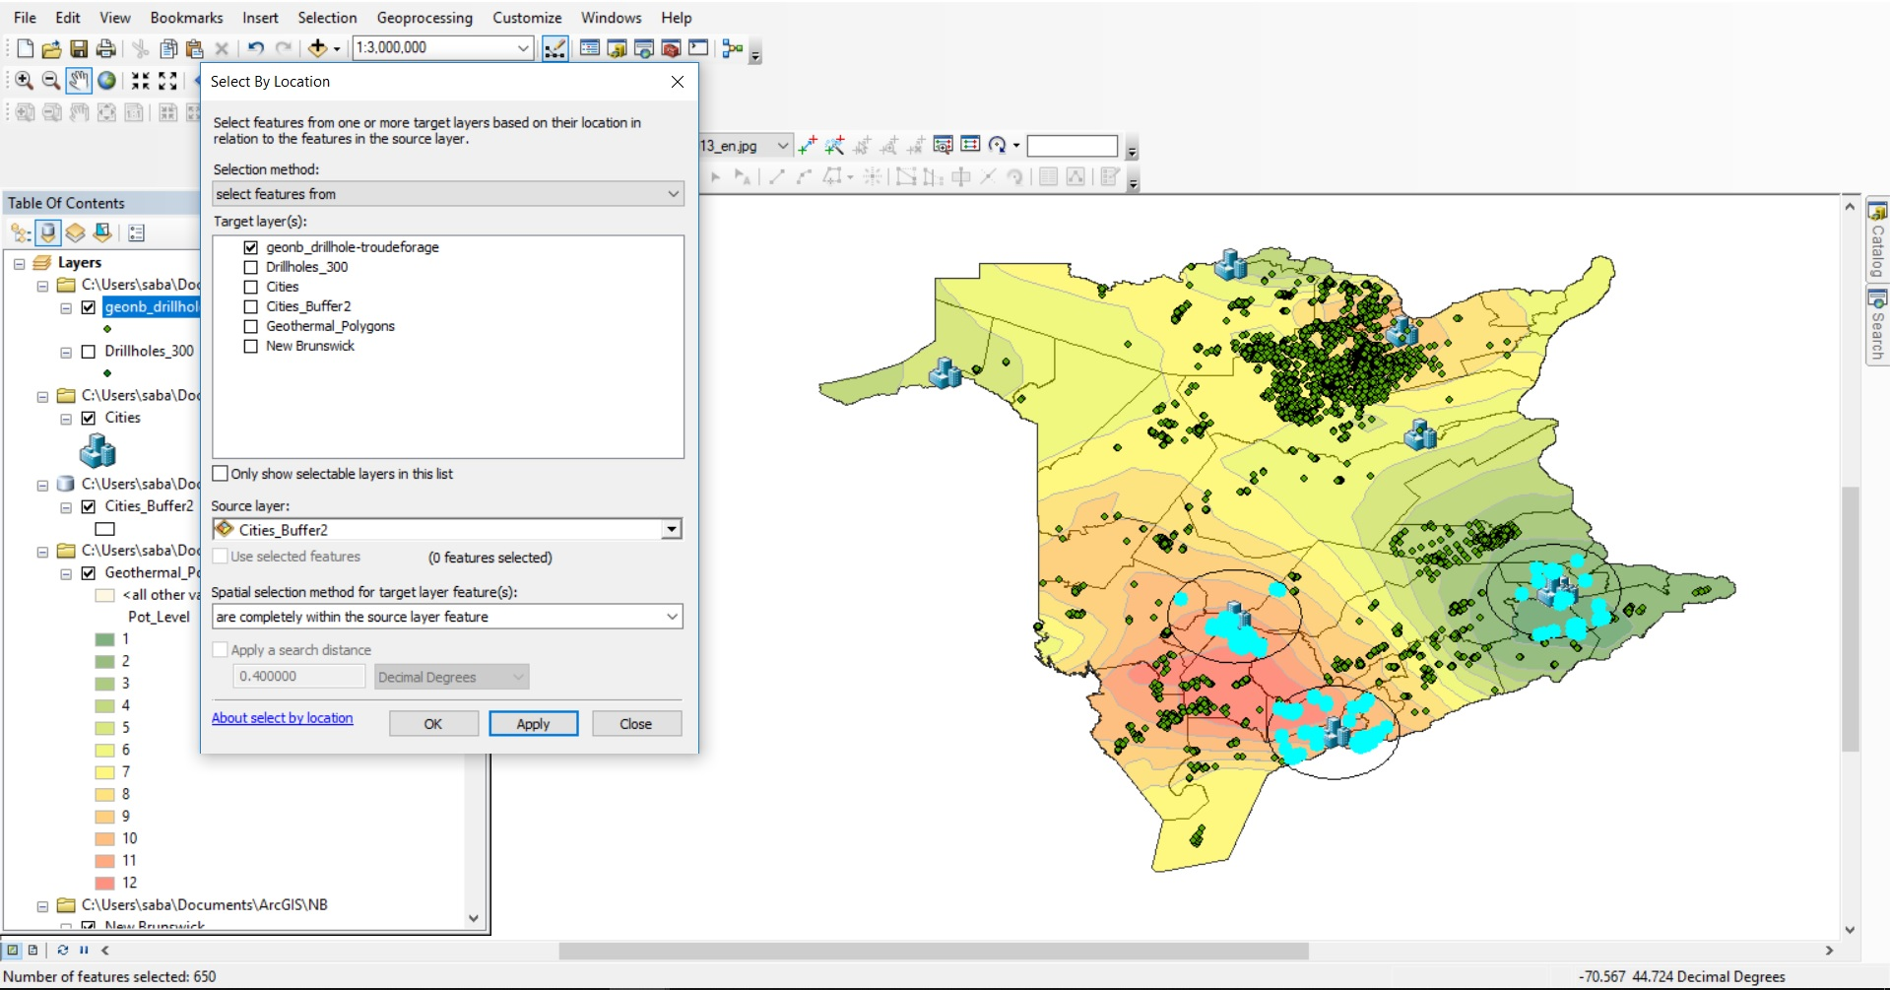
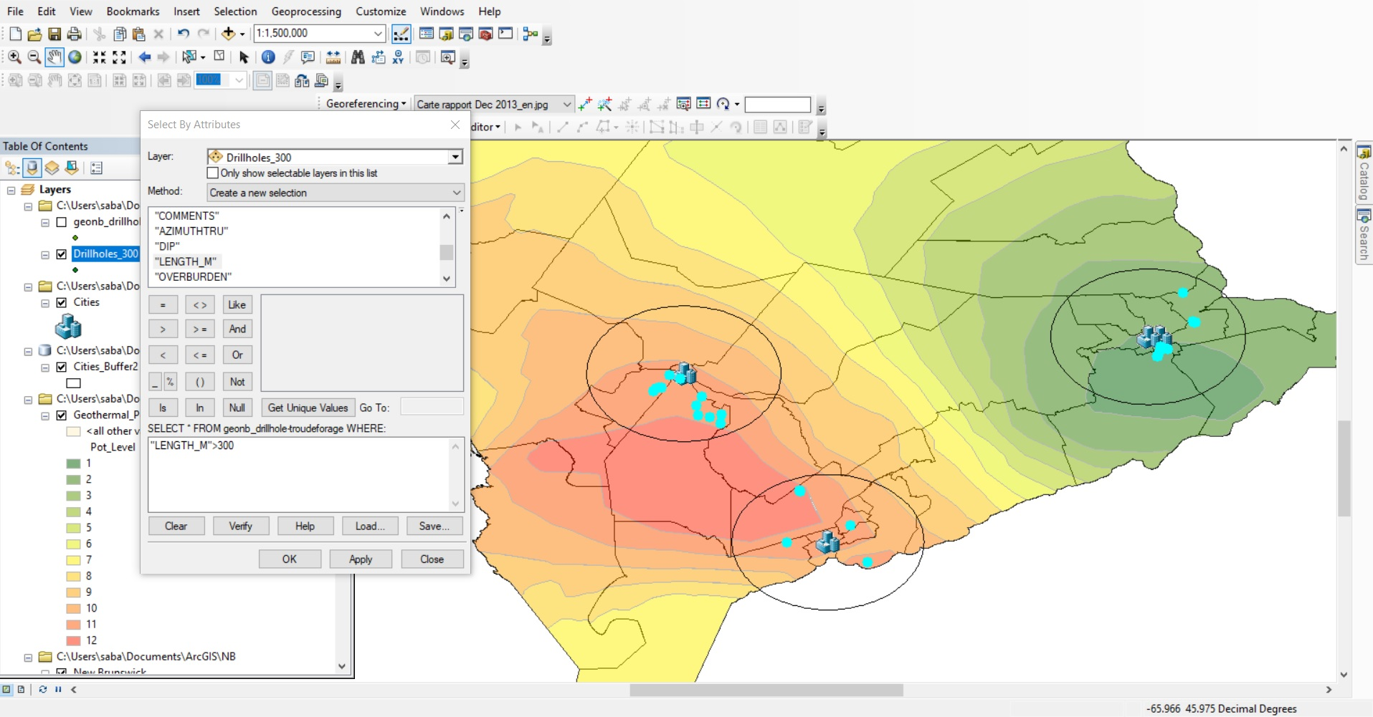
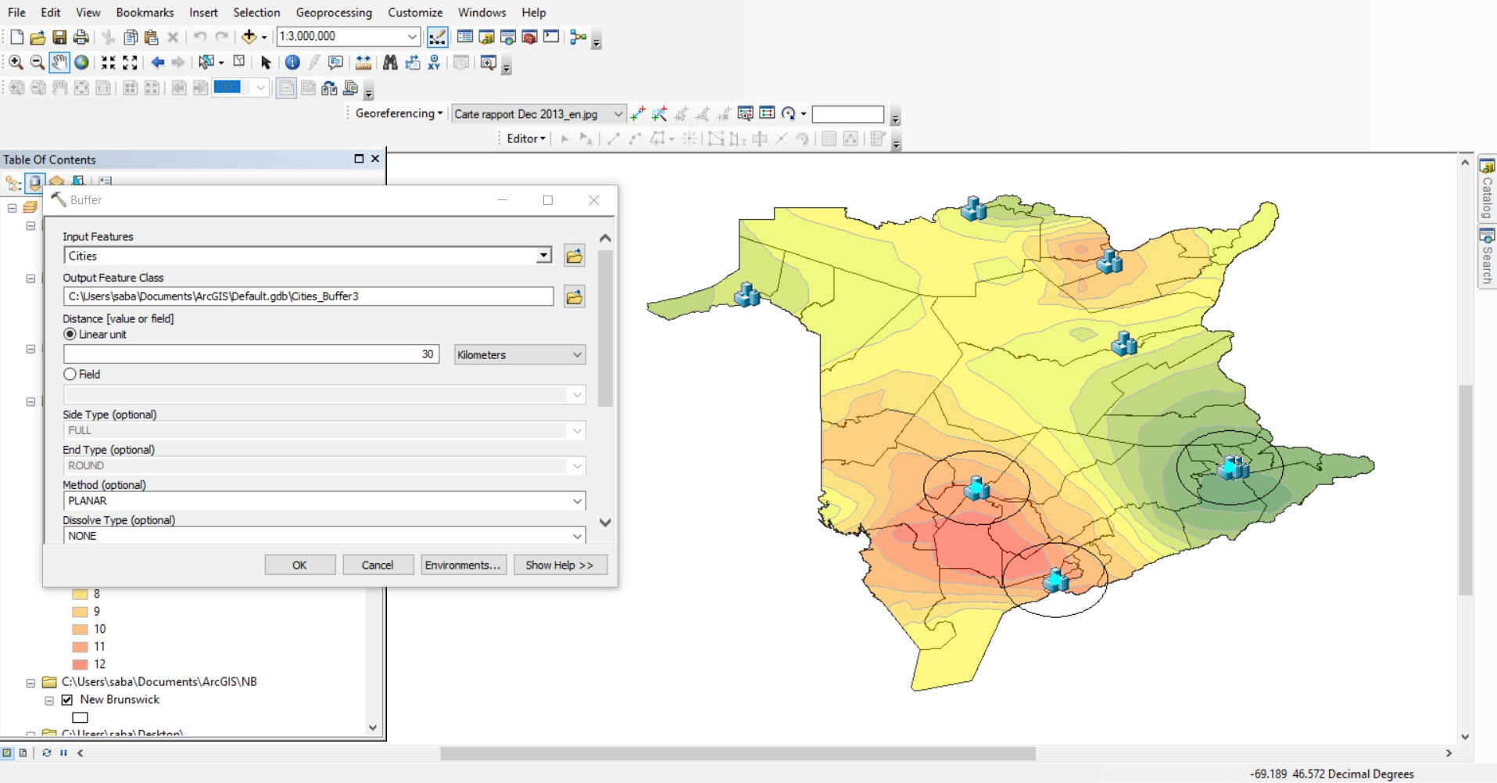
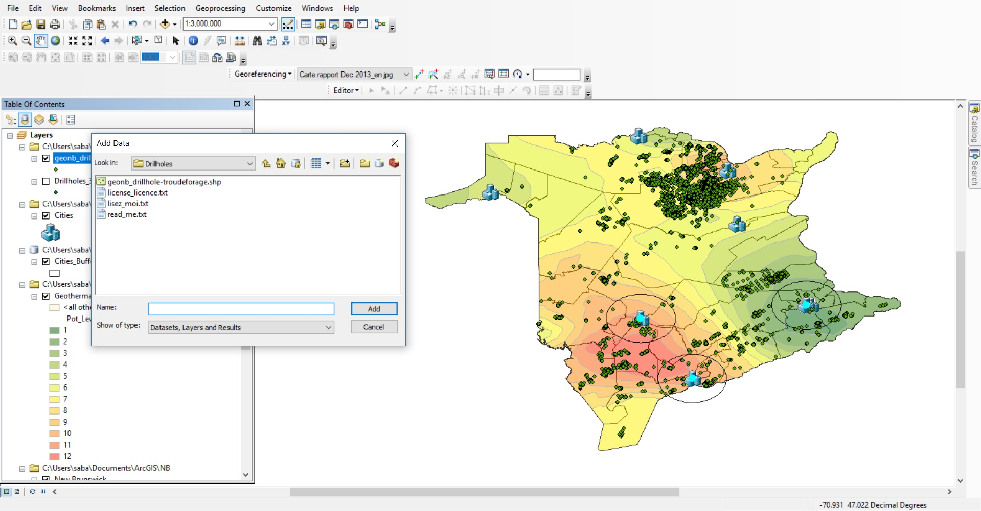
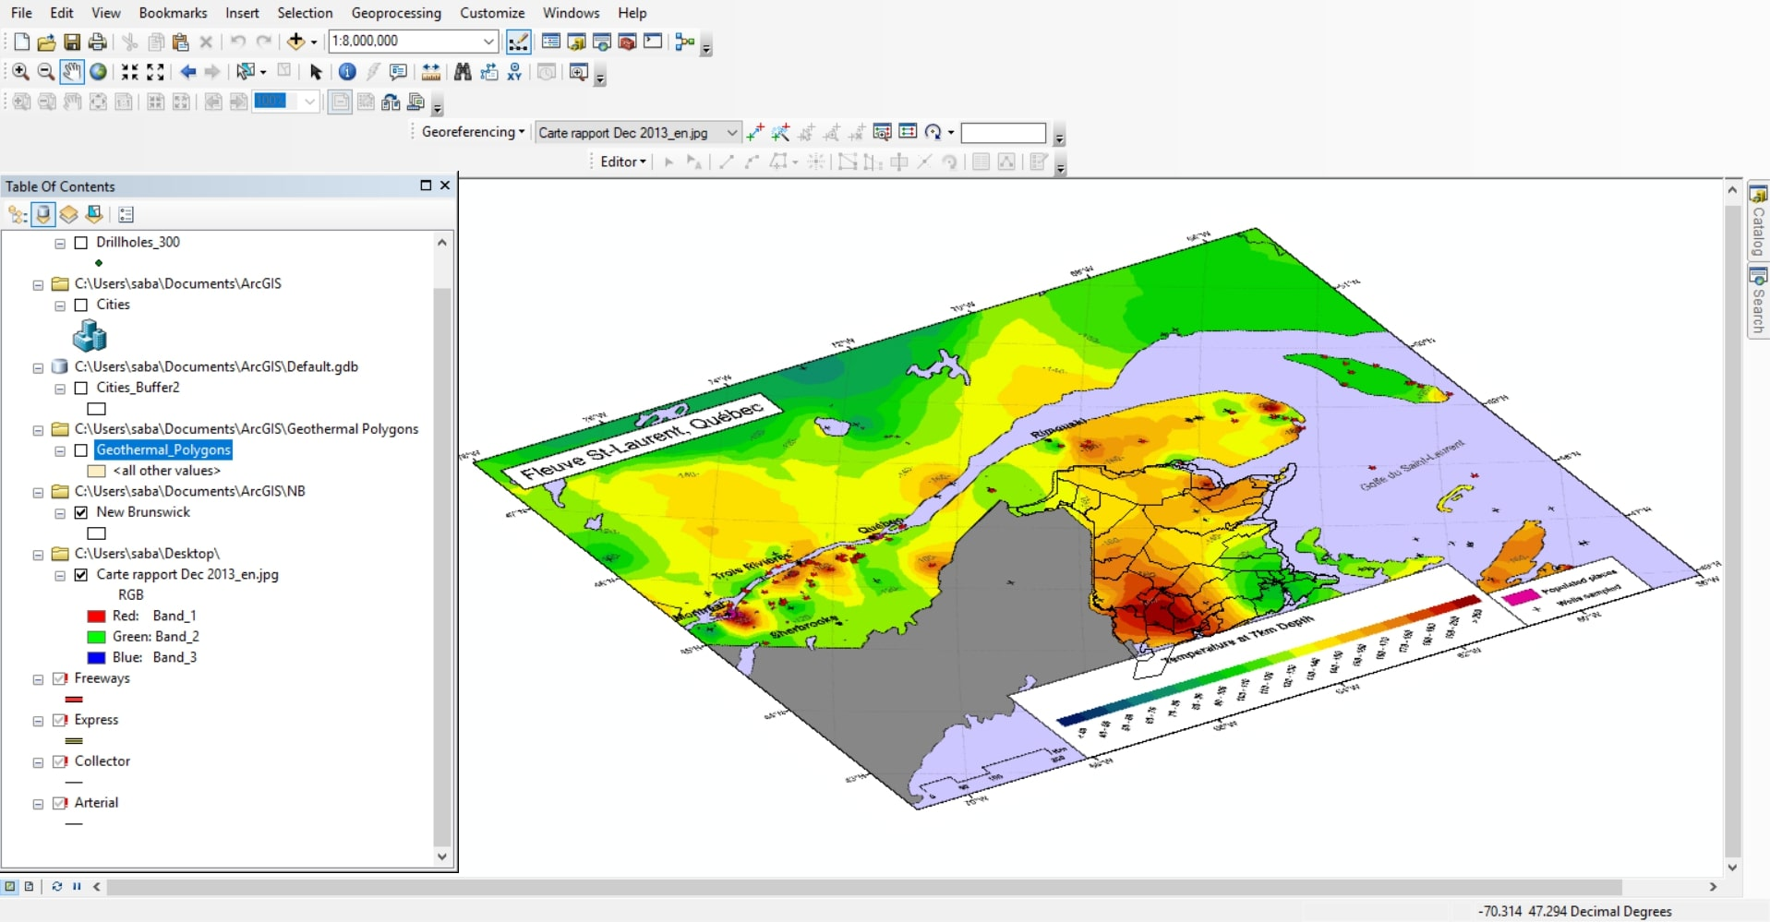
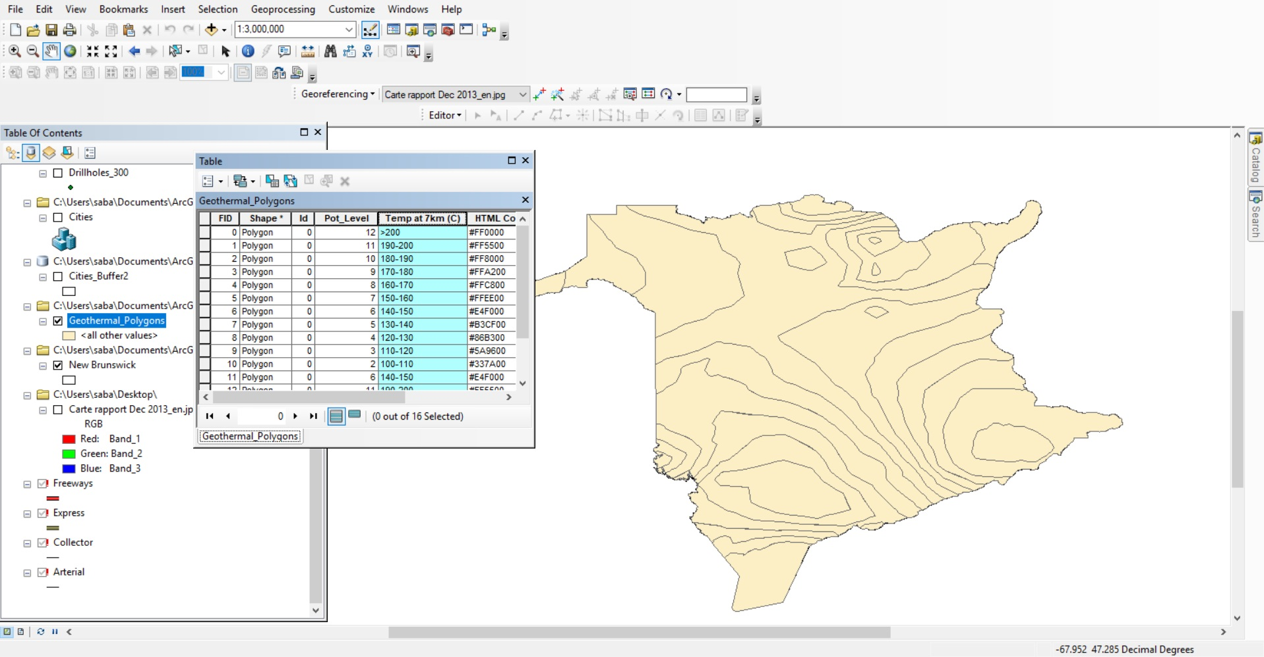
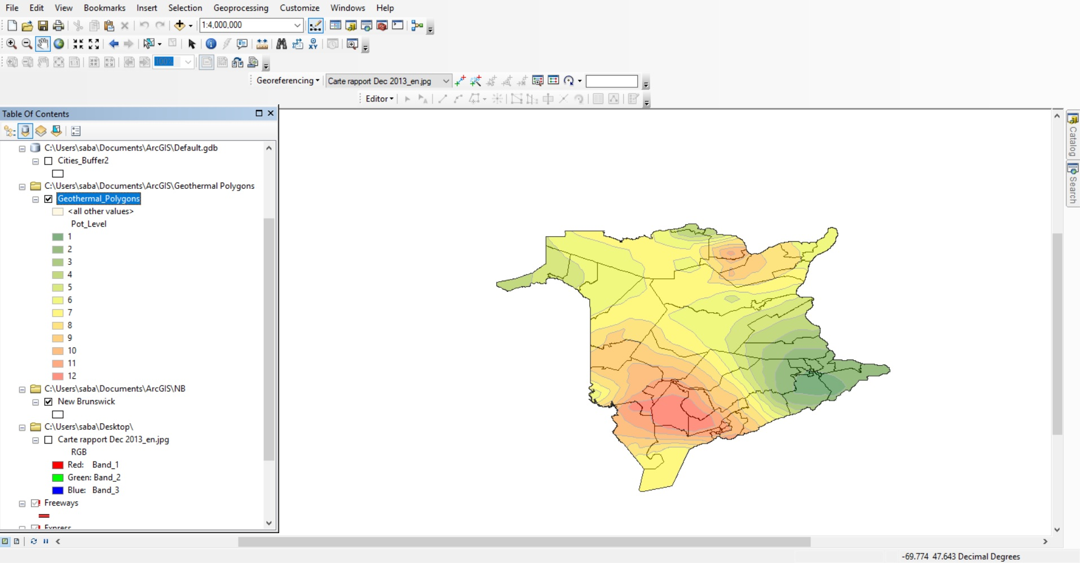
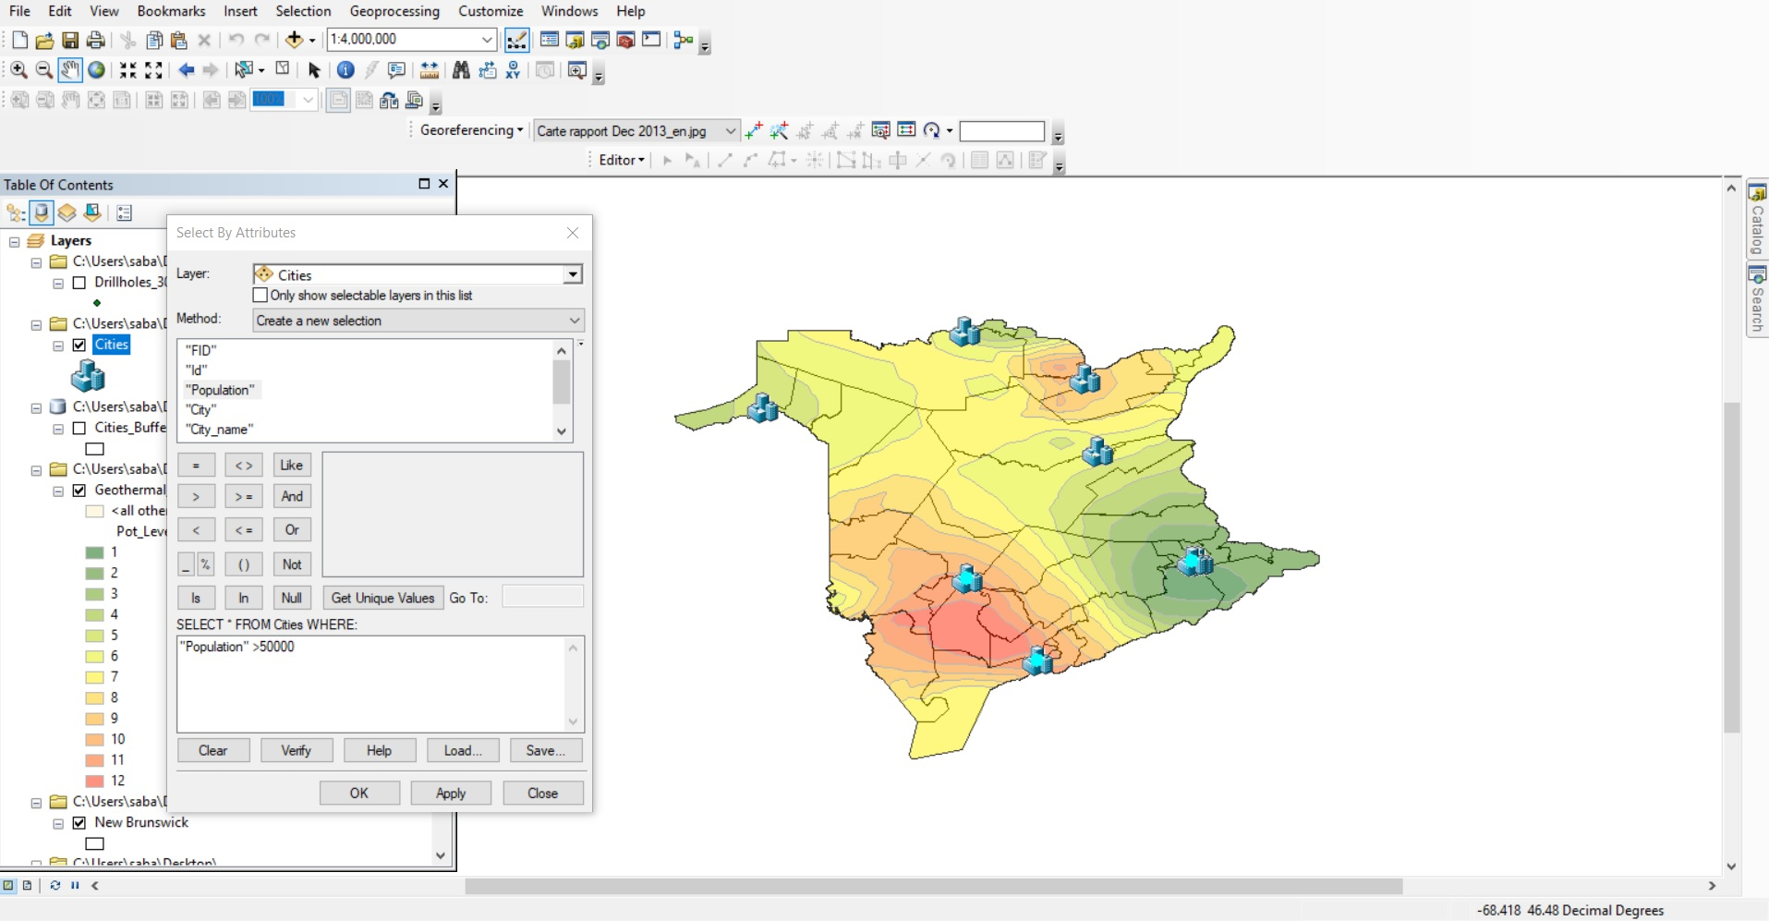
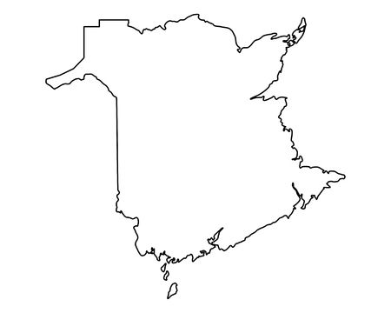
Geothermal
Selecting More Populated Cities
Selecting the Ones Deeper than 300m
Selecting the Ones Within the Created Buffers
Inserting Geothermal Potential Values
Georeferencing Geothermal Potential Map
Geothermal Map of New Brunswick
Adding Mineral Drillings Dataset
30km Buffer
Where would be an ideal location for a geothermal power plant across New Brunswick?!

Slide 8
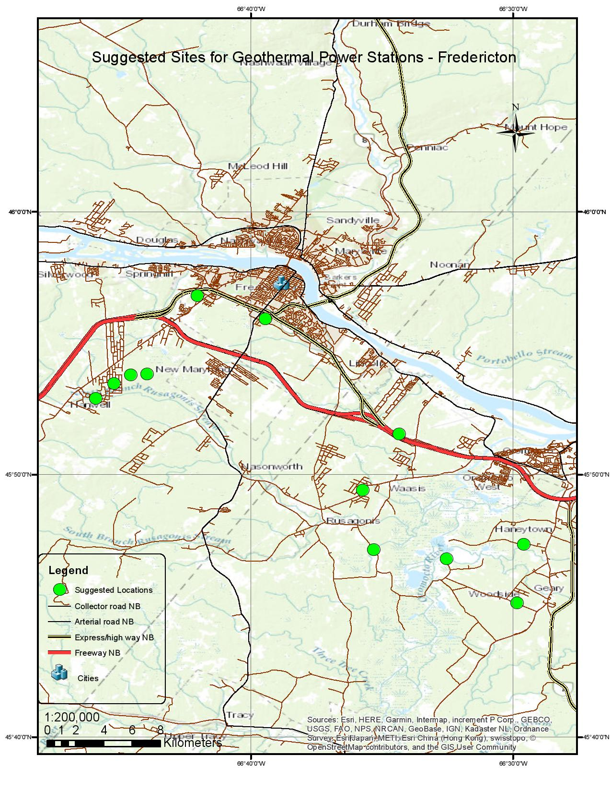
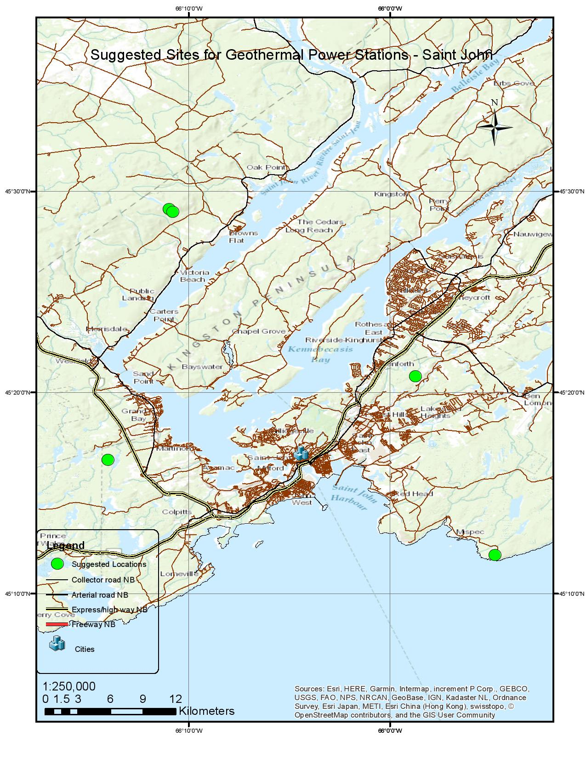
Geothermal

Slide 9

Tidal Energy
Tidal energy is generated from power found in ocean tidal currents and the use of tidal height differences. Tidal range may vary over a wide range (4.5-12.4 m) from site to site. A tidal range of at least 7 m is required for economical operation and for sufficient head of water for the turbines.
Apart from having the many advantages like enormous energy production, high predictability of the tides, it has few disadvantages like danger to fish and other sea-life and an increase in coastal erosion where the tides are concentrated.

Slide 10
Tidal Energy
Factors taken into consideration
Factors affecting the location of a Tidal Station
Tidal height (should be at least 7 m)
Marine Life
Wildlife
Federal criteria
be located a minimum of 1,000 m away from any existing power station;
be located a minimum 1000 m away from: operating aquaculture sites, marine zone or national parks

Slide 11
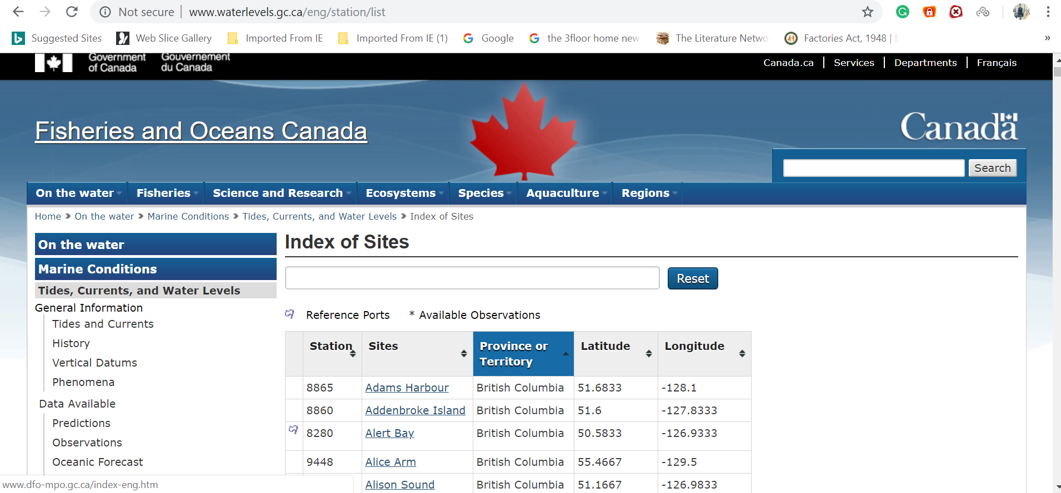
Tidal Energy
Data Collection And Extraction
Extraction of Tidal Points

Slide 12
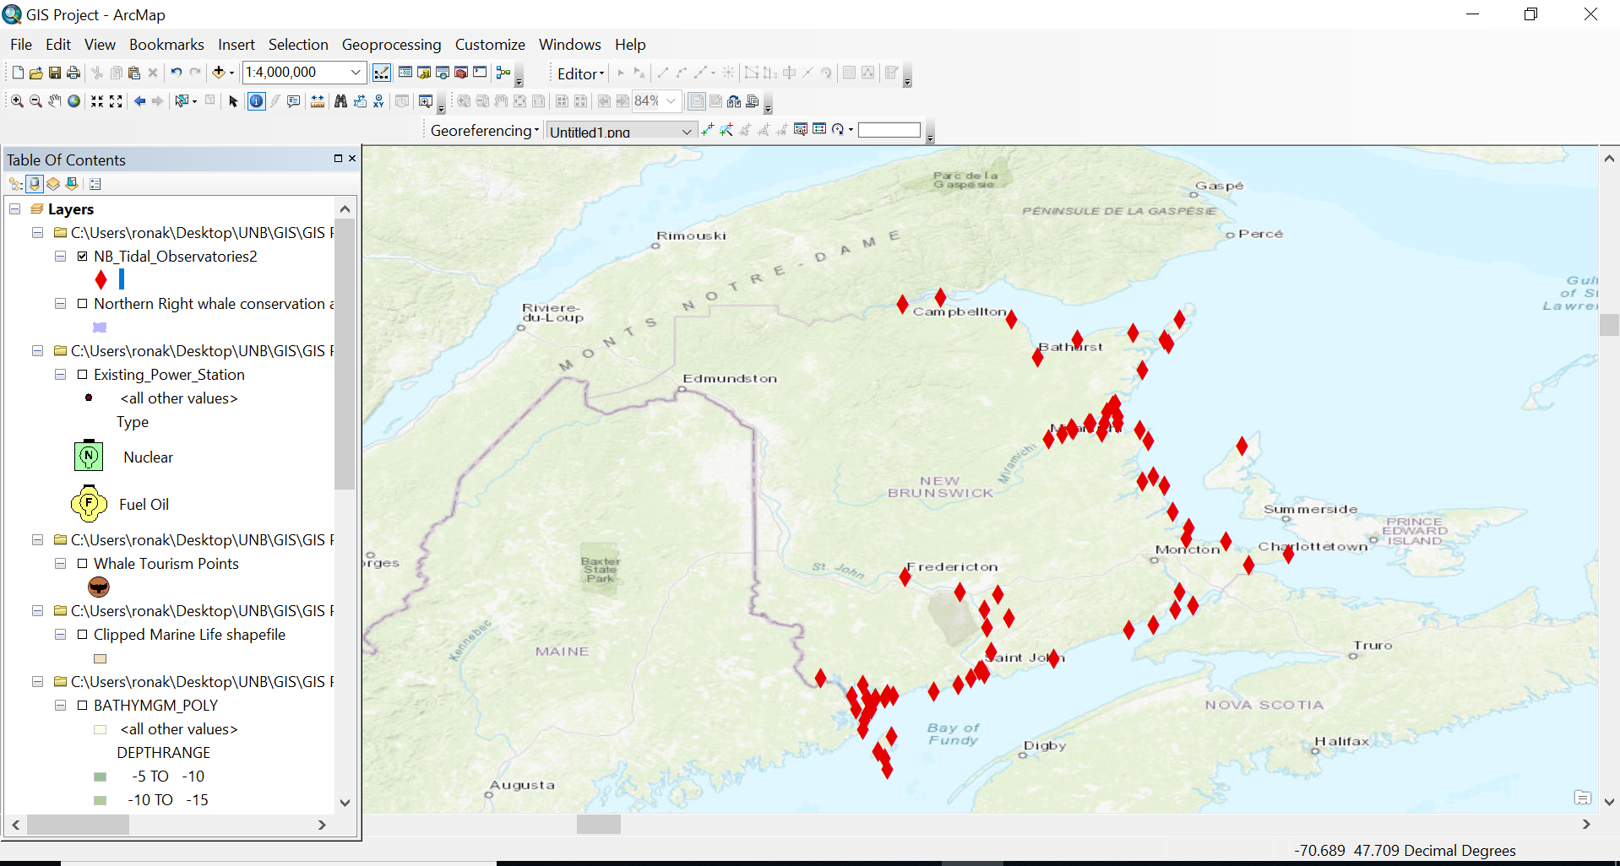
Tidal Energy
Extracted Tidal Points

Slide 13
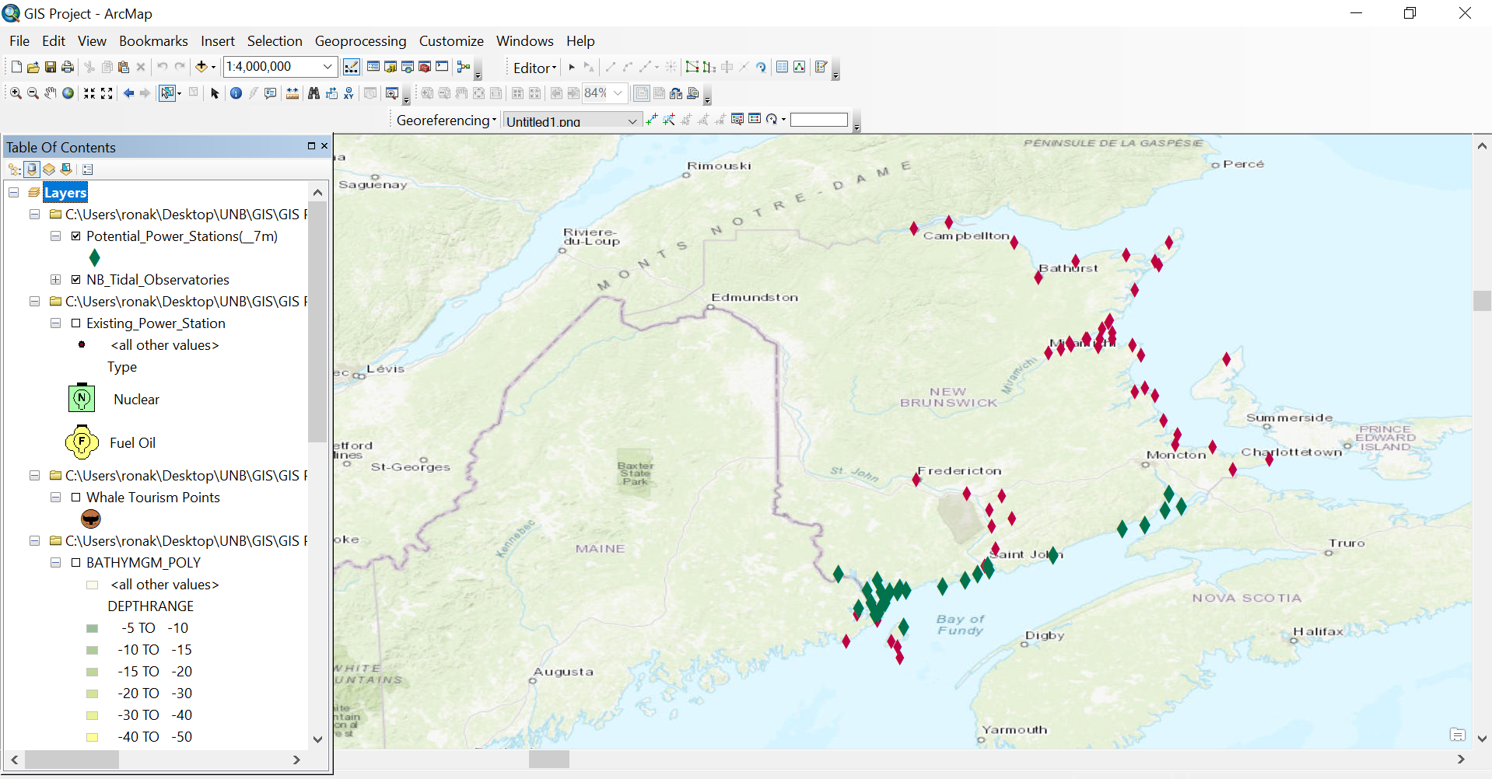
Tidal Energy
Extracted Tidal Points
Green Points shown the potential points

Slide 14
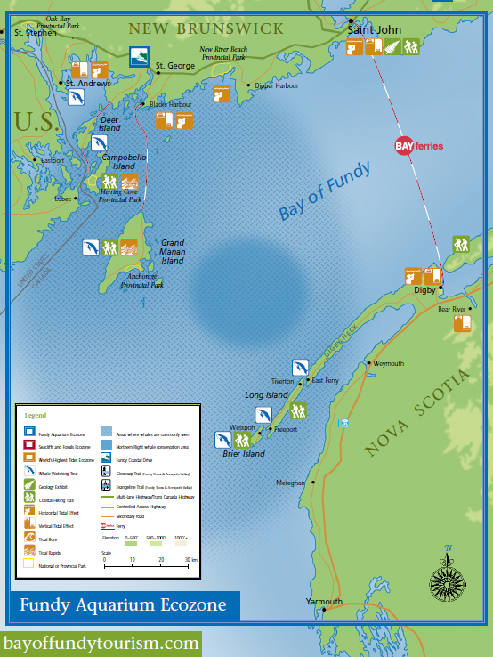
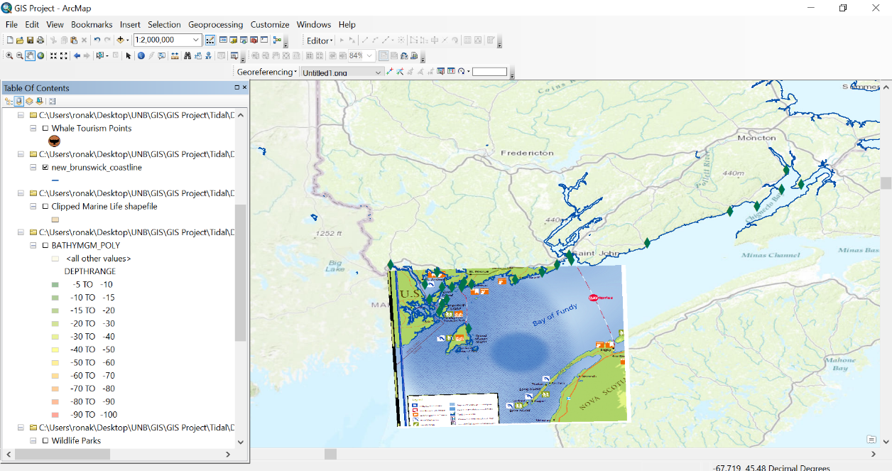
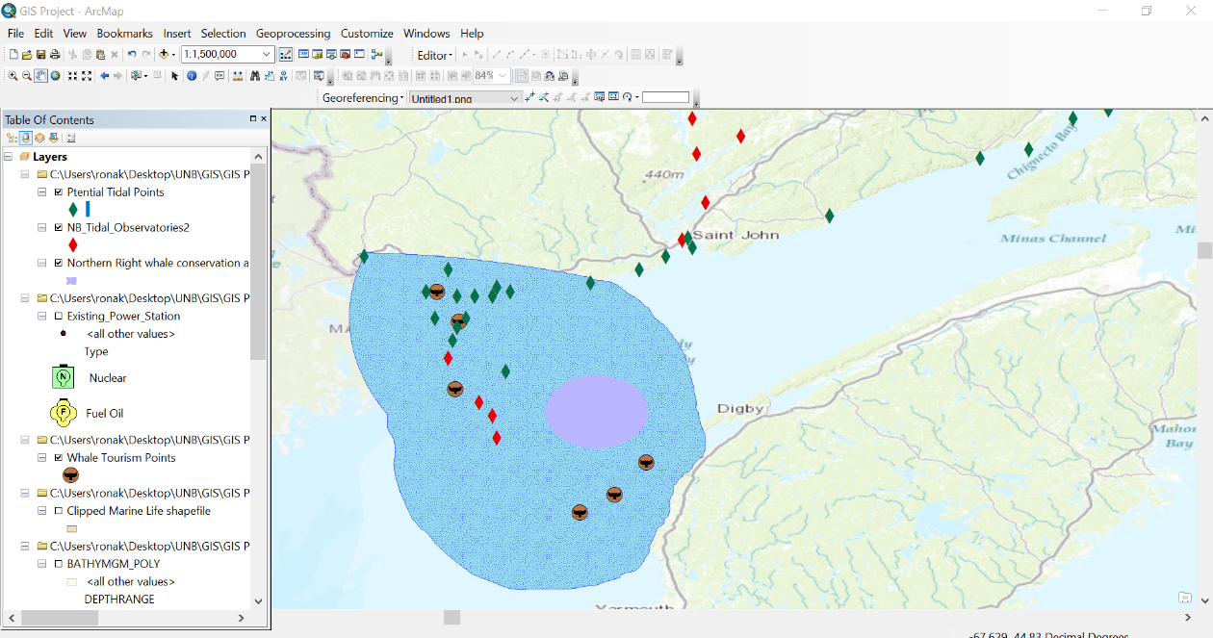
Tidal Energy
Georeferencing Image

Slide 15
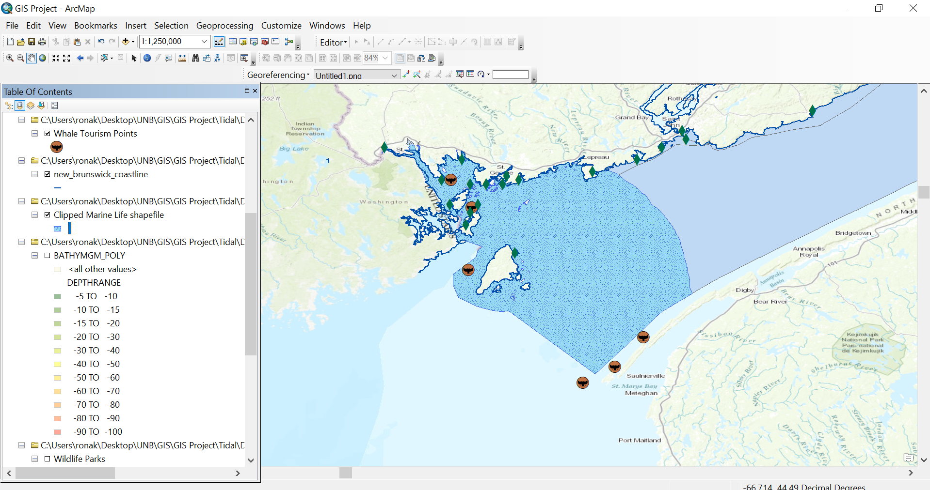
Tidal Energy
Clipped Marine Zone shapefiles

Slide 16
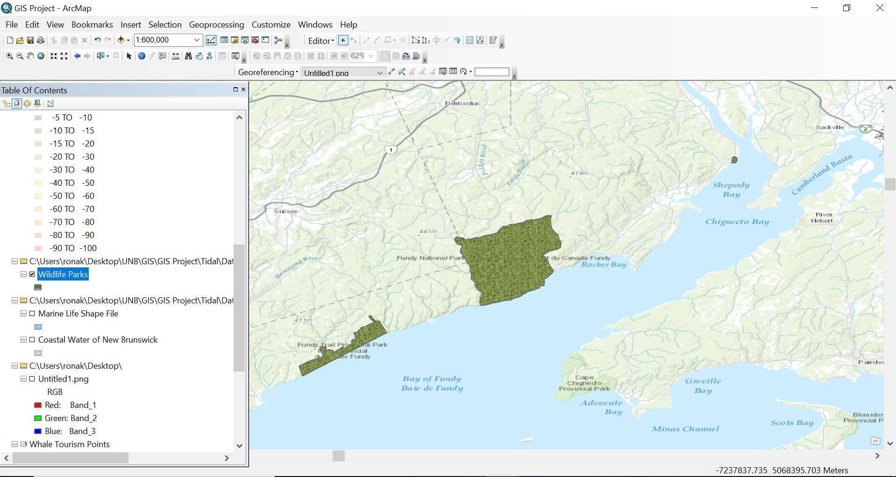
Tidal Energy
National Parks in the vicinity

Slide 17
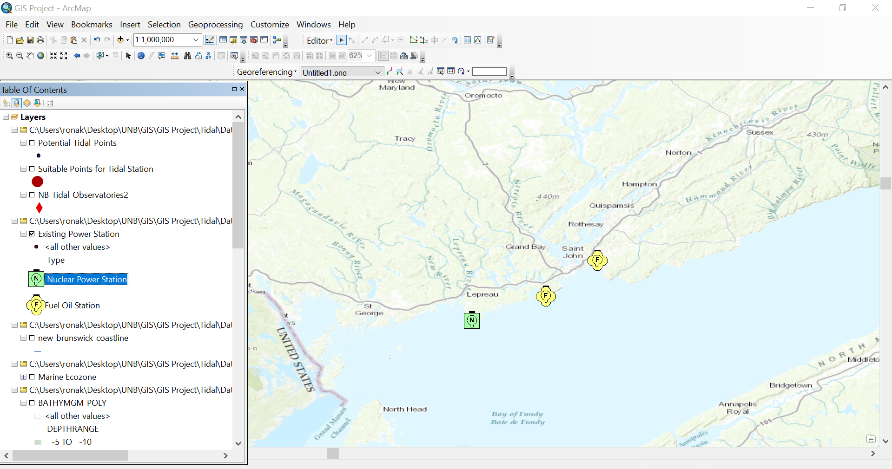
Tidal Energy
Existing Power Stations in the vicinity

Slide 18
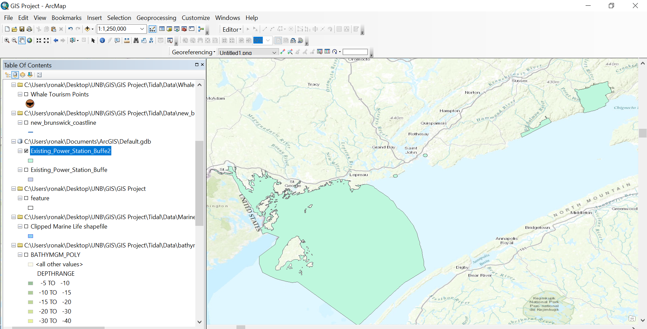
Tidal Energy
Unsuitable Zone for Tidal Stations

Slide 19
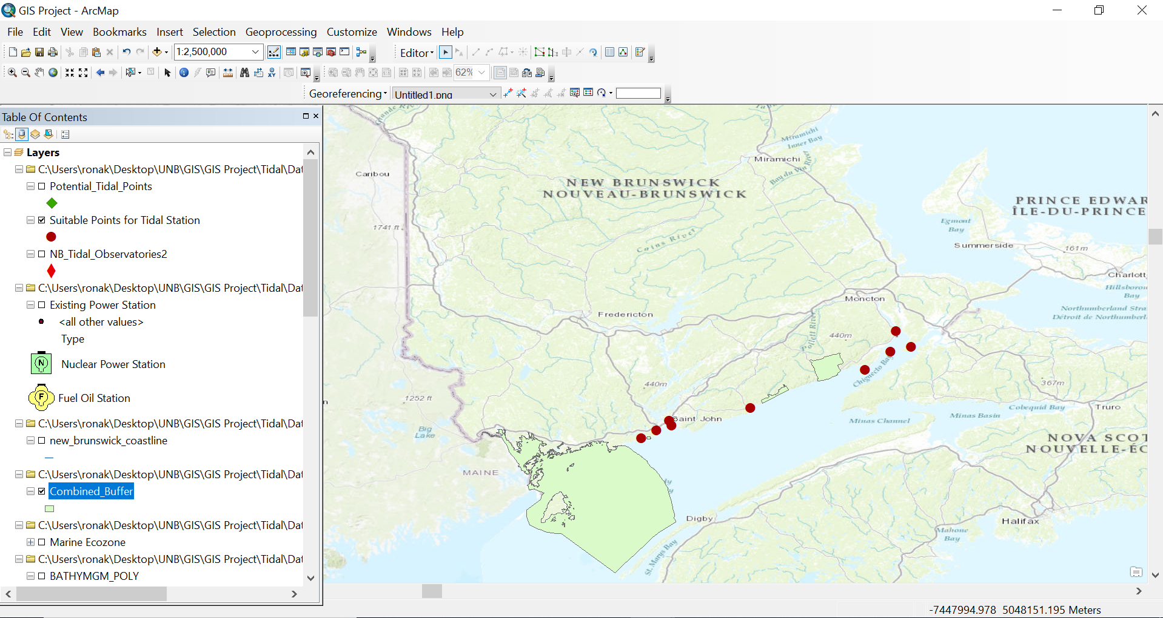
Tidal Energy
Suitable Zone for Tidal Stations

Slide 20
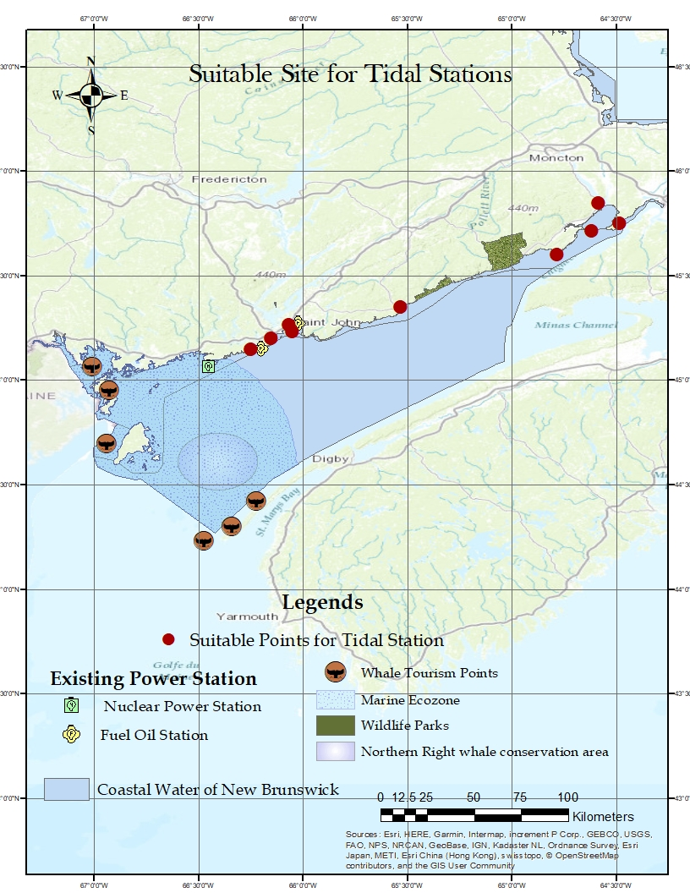
Tidal Energy

Slide 21
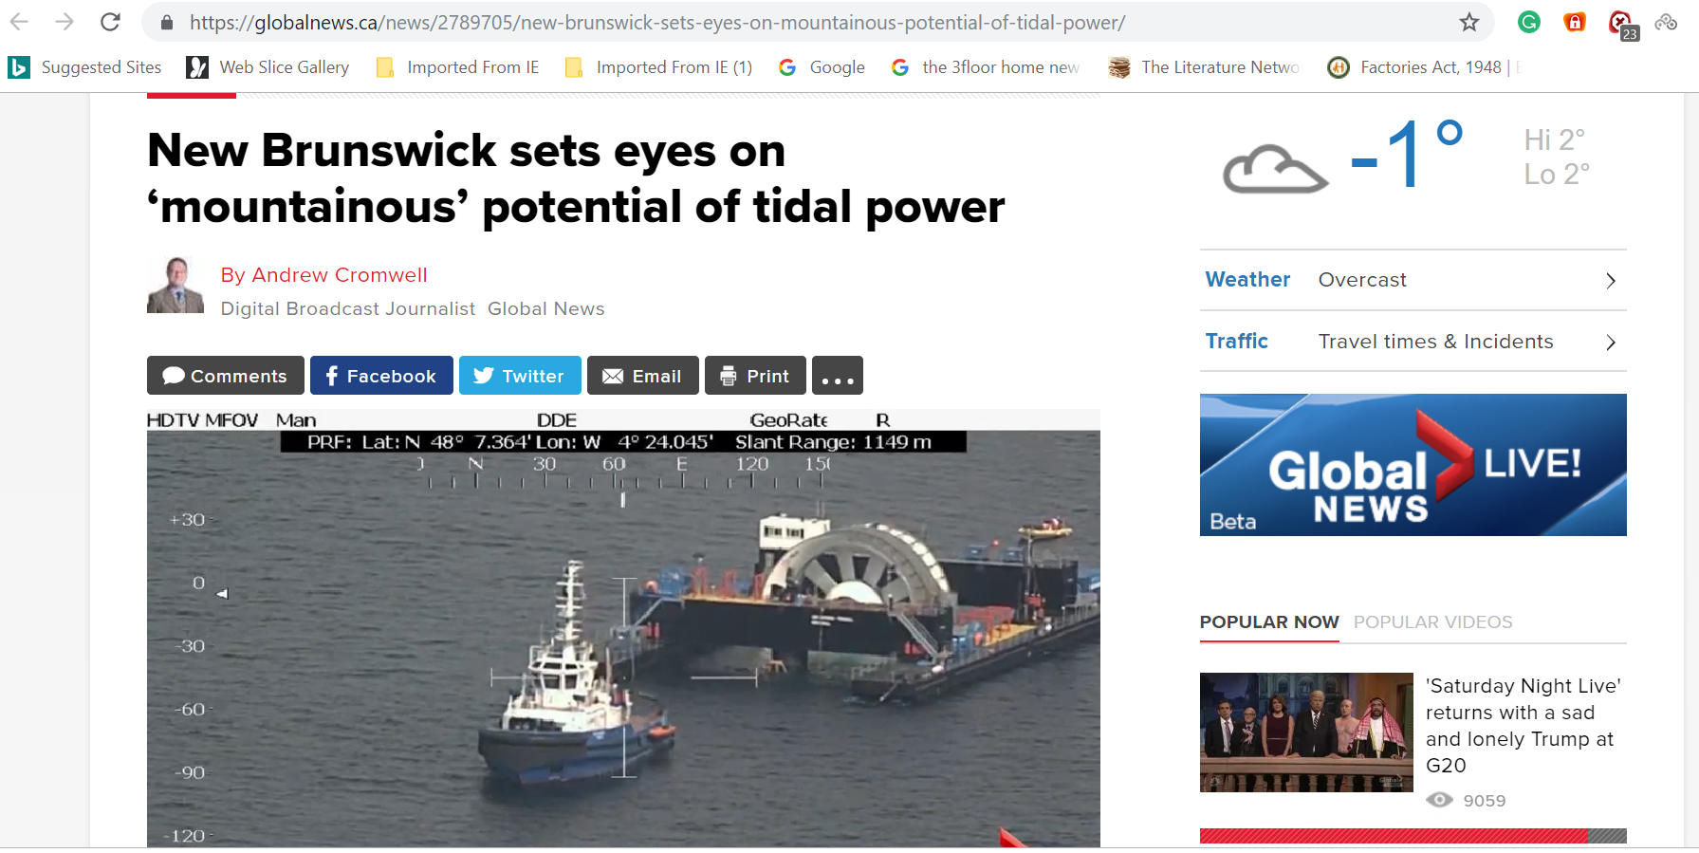
Tidal Energy
As a matter of fact …

Slide 22
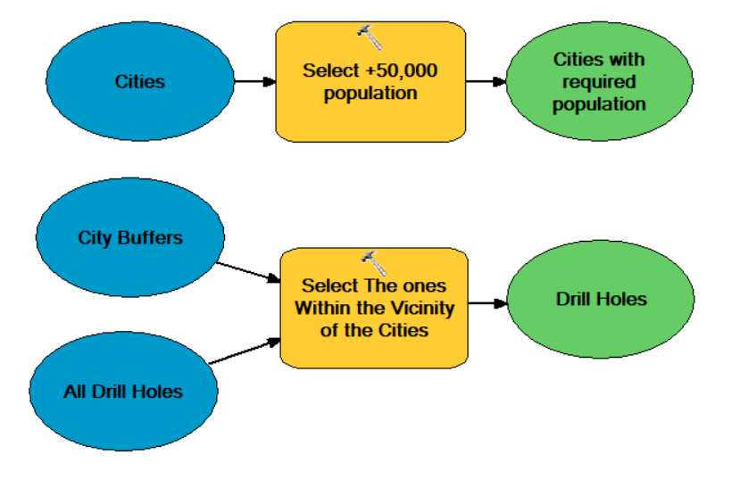
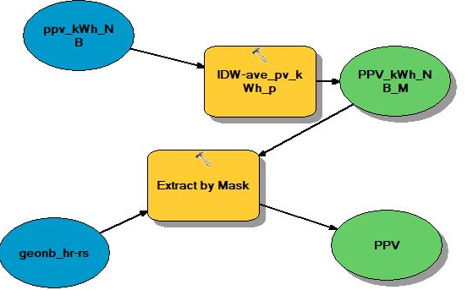



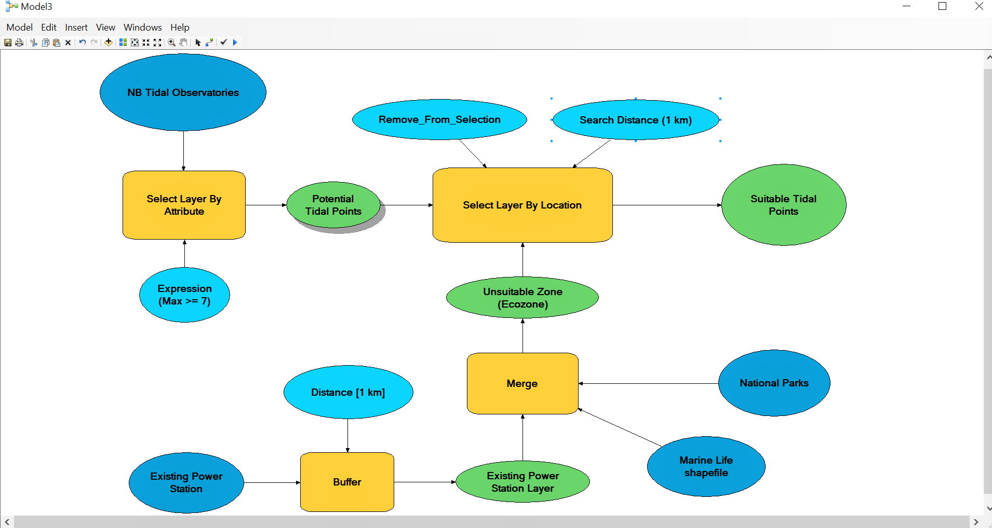
Model Builders

Slide 23
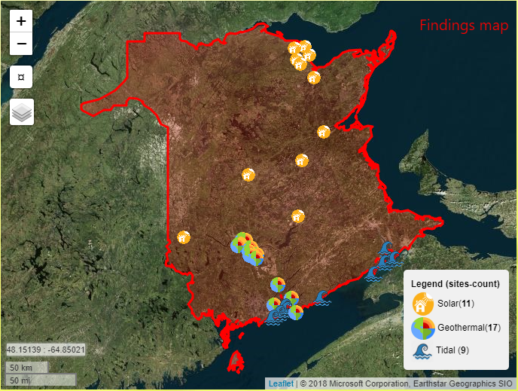
Suggested sites
Reference: renewsites.pythonanywhere.com

Slide 24
Video here

Slide 25
Thank You…!!

